Slide 1
Predicting Mortality by Heart Failure
Trevor Maxwell
2024-03-01

Slide 2
contents
Introduction to Heart Failure
Dataset Used
Exploratory Data Analysis
Models Deployed
Results
Conclusion and Next Steps
Ethical Considerations

Slide 3
Introduction to Heart failure
Heart failure:
the heart cannot pump enough blood for the body to properly function
The heart cannot fill up with enough blood
Many types of heart diseases which can lead to heart failure
Developing factors:
Family history/genetics, age, medical history, lifestyle habits, etc.,.
Millions of individuals are affected each year in the United States
In 2019, heart disease was the leading cause of death globally

Slide 4
Dataset used
Contains 299 observations of patients who have heart disease and were admitted to a hospital
13 features including:
Age
Blood pressure indicator
Diabetes indicator
Sex
Smoking indicator
Anaemia
Platelets
Other cardiac lab results
Time
Follow up period for the next visit
Target variable:
Death Event
Whether the patient deceased within the follow-up period

Slide 5
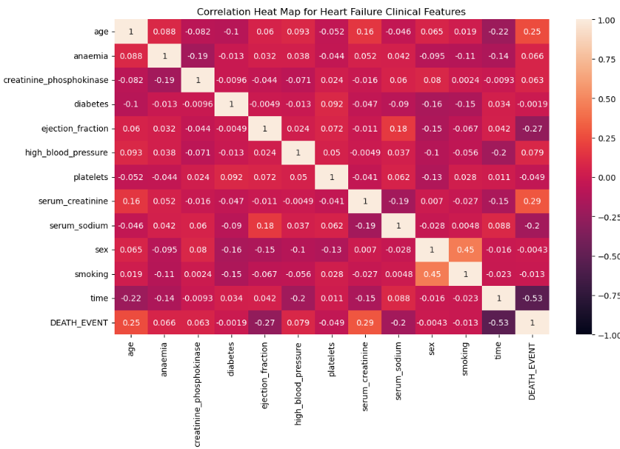
Exploratory Data analysis (eda)
No highly correlated variables
No variables removed due to high correlation
Most correlated variables
Death Event and time: -0.53
Death Event and serum_creatinine: 0.29
Level of serum creatinine in the blood
Death Event and ejection fraction: -0.27
Percent of the blood leaving the heart

Slide 6
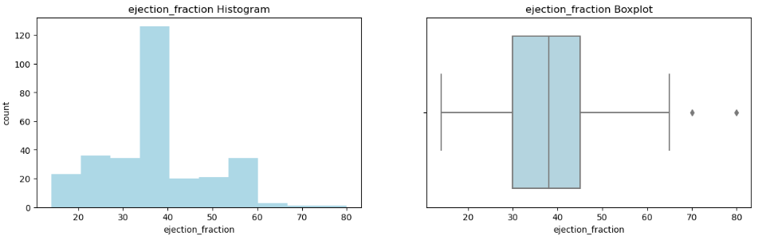
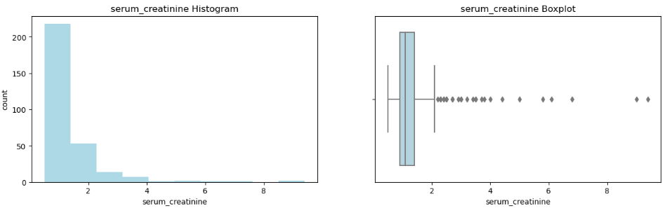
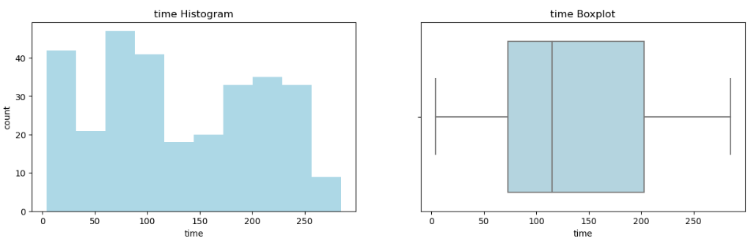
Exploratory Data analysis (continued)
Ejection Fraction
25th percentile – 30%
50th percentile – 38%
75th percentile – 45%
Serum Creatinine
Skewed to the right
Time
25th percentile – 73 days
50th percentile – 115 days
75th percentile – 203 days

Slide 7
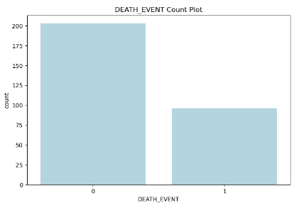
Exploratory Data analysis (continued)
Just over 2/3 of observations survived
Death event 0: 203
Remaining observations did not survive
Death event 1: 96

Slide 8
Models deployed
Logistic Regression
Accuracy: 80.00%
Precision: 88.00%
Recall: 59.46%
F1 Score: 70.97%
KNN Classifier
Accuracy: 71.67%
Precision: 66.67%
Recall: 21.05%
F1 Score: 32.00%
Random Forest
Accuracy: 85.00%
Precision: 77.78%
Recall: 73.68%
F1 Score: 75.68%.

Slide 9
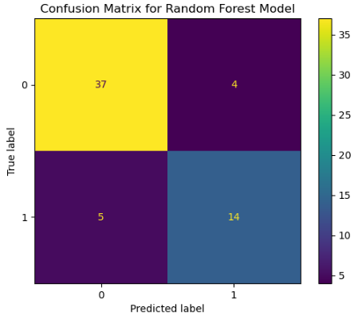
Results
Random Forest Model Confusion Matrix
True Positives: 37
False Positives: 4
True Negatives: 14
False Negatives: 5
Recall score is very important due to the nature of the analysis
73.68%

Slide 10
Conclusion and next steps
Random Forest Classifier was the best model for the purpose of this project
Based on accuracy and recall scores
Use cases of the model
Reduce decision fatigue on doctors
Reduce follow-up time for patients that have a death event prediction
Provide additional care for patients that are predicted as having a higher risk
Patients with negative predictions will still be treated and evaluated by medical professionals

Slide 11
Ethical implications
More than what is contained in the data impacts health outcomes
Diets, prior comorbidities, lifestyle habits, etc.,.
Doctors should not use the model for all decisions
Model is meant to aid the doctor, not decide for the doctor
Dataset is small compared to the number of individuals that have heart failure
Possible misrepresentation of the entire population

Slide 12
references

